Slide 1

Introduction to Information Systems ITISA1

Slide 2


Disclaimer
Please note that the content made available on myLMS may deviate slightly from what is covered in lecturer-led sessions. However, the material on myLMS, along with prescribed textbooks and any other designated learning resources, constitutes the compulsory content students are expected to consult and prepare for assessments.

Slide 3
What will be covered in the rest of today’s session?
What will be covered in the lecture-led session:
Introduction to e-Commerce
Types of e-commerce
E-Government

Slide 4
Why e-commerce ?
e-Commerce has transformed many areas of our lives and careers.
One fundamental change has been the way organizations interact
Most organizations today have set up business on the Internet

Slide 5
What is e-Commerce
E-commerce: conducting business activities electronically over computer networks
Business activities proven to be strong candidates for conversion to e-commerce:
Paper based
Time-consuming
Inconvenient for customers

Slide 6
E-Commerce Types
E-commerce categories
Business-to-business (B2B)
Business-to-consumer (B2C)
Consumer-to-consumer (C2C)
Mobile commerce (m-commerce)
Many benefits: smartphone Internet access
Some limitations: small display space

Slide 7
Business-to-Business (B2B)
Subset of e-commerce
All participants are organizations
Useful for connecting business partners in a virtual supply chain to cut resupply times and reduce costs
Many organizations use both buy-side and sell-side e-commerce
Buy-side e-commerce: purchase goods and services from suppliers
Sell-side e-commerce: sell products to customers

Slide 8







































Slide 9




































Slide 10
Business-to-Consumer (B2C)
Customers deal directly with an organization
Producers and providers of consumer products can eliminate middlemen
Steady growth
Cheaper goods and services online
Online shoppers can design a personalized product
Use of social media networks to promote products and reach customers

Slide 11
Consumer-to-Consumer (C2C)
Involves electronic transactions between consumers facilitated by a third party
Popular sites: eBay, eBid, Etsy, Fiverr, Ibidfree, Kijiji, Ubid, Facebook Marketplace, and Taobao
Companies and individuals involved in C2C must be careful
Sales must not violate the rules of various county, state, and country legal jurisdictions

Slide 12
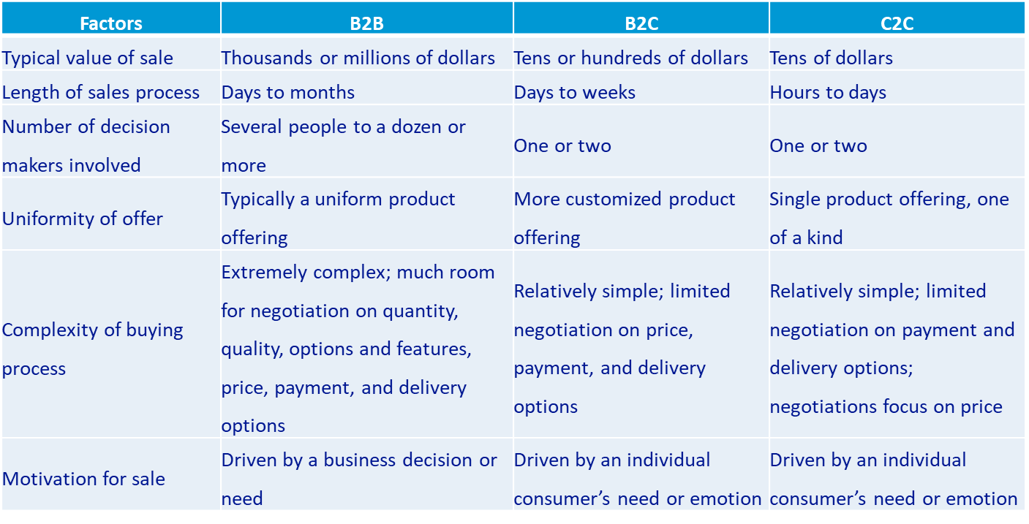
Comparison..

Slide 13
E-Government
Use of information and communications technology to:
Simplify information sharing
Speed formerly paper-based processes
Improve relationships between citizens and government
Forms of e-government:
Government-to-consumer (G2C)
Government-to-business (G2B)
Government-to-government (G2G)

Slide 14
M-Commerce
Concepts and strategies are the same, but tactics of e-commerce had to change
Smaller-sized user interface
Mobile commerce (m-commerce) relies on use of wireless devices to place orders and conduct business
Smartphones and tablets

Slide 15
Advantages of E-Commerce
Conversion to an e- or m-commerce system enables organizations to:
Reach new customers
Reduce costs
Speed the flow of goods and information
Increase the accuracy of orders
Improve customer service

Slide 16
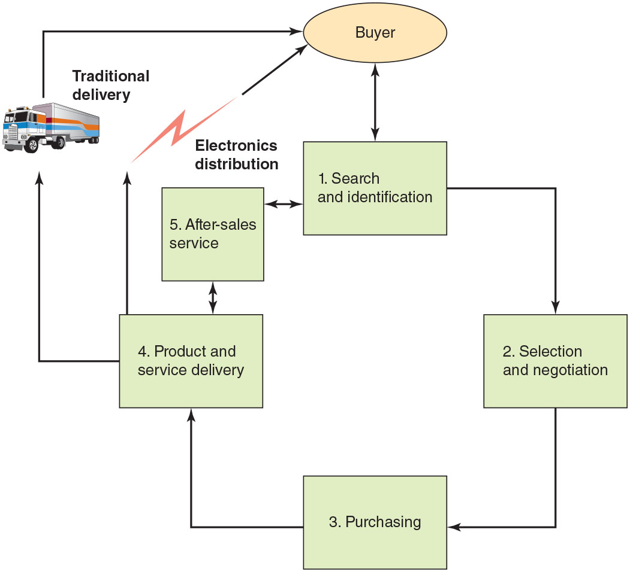









Multistage Model for E-Commerce

Slide 17
Activity
Which e-commerce model is it, when a student uses the Internet to purchase inventory items from a vendor company.
Discuss the challenges of e-commerce and m-commerce in South Africa?
Discuss the impact has Covid 19 on eCommerce and MCommence?
In what ways has the eCommerce and MCommerce changed the way businesses operate.
Discuss why E-Government is important?

Slide 18
Activity
Visit an e-commerce website like Takealot or Amazon and check for the functionalities that enable a customer to make a purchase.

Slide 19
What will be covered in the rest of today’s session?
What will be covered in the lecture-led session:
Multistage Model for E-Commerce
Social Media Commerce
E-Commerce Challenges
E-Commerce and M-Commerce Applications
Strategies for Successful E-Commerce and M-Commerce

Slide 20
Multistage Model for E-Commerce
A successful e-commerce system must address the many stages that consumers experience in the sales life cycle:
Search and identification
Select and negotiate
Purchase products and services electronically
Deliver products and services
After-sales service

Slide 21
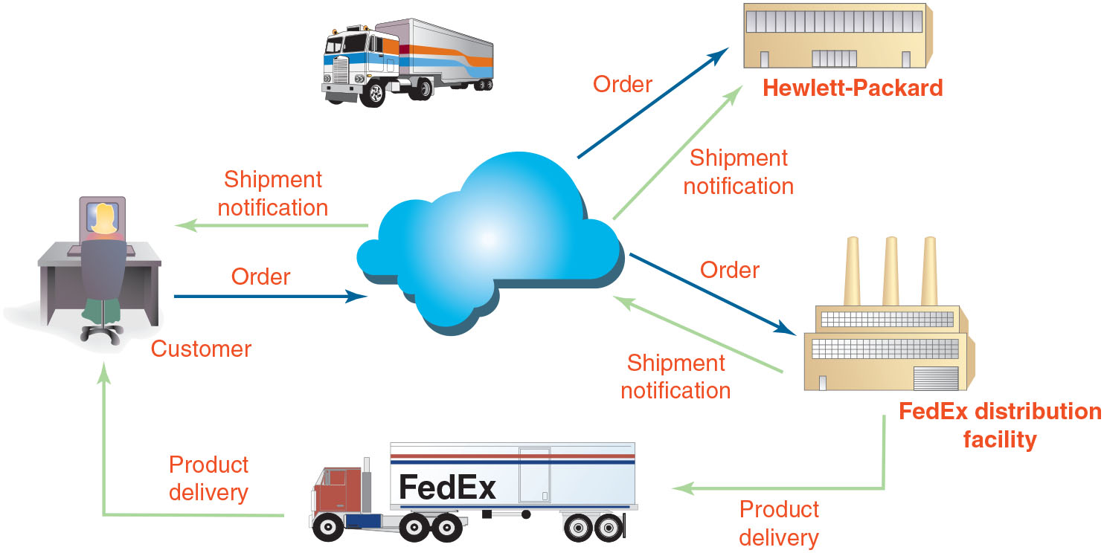
Multistage Model for E-Commerce
Product and Information flow When a customer orders an HP printer online, the order goes first to FedEx, which ships the order, triggering an email notification to the customer and an inventory notice to HP.

Slide 22
Social Media Commerce
Social commerce is the buying and selling of goods or services directly within a social media platforms for example Facebook, Twitter, Tiktok, Instagram etc.
On social media it is easy for the online shop to flight targeted adverts to the audience based on their age, location and other social groups affiliated to them.
The customers can also share and recommend products to their social circle.

Slide 23

E-Commerce Challenges
Three key challenges to e-commerce
Dealing with consumer privacy concerns
About one-third of all adult Internet users will not buy online due to privacy concerns
Overcoming consumers’ lack of trust
Online marketers must create specific trust-building strategies for their Web sites
Overcoming global issues
Cultural, language, time and distance, infrastructure, currency, and law challenges

Slide 24
E-Commerce and M-Commerce Applications
Areas in which applications are used
Wholesale e-commerce
Manufacturing
Marketing
Advertising
Bartering
Retargeting, price comparison, and couponing
Investment and finance
Banking
Online personalized shopping

Slide 25
Strategies for Successful E-Commerce and M-Commerce
Companies must develop effective Web sites that include the following characteristics:
Easy to use
Accomplish the goals of the company
Safe and secure
Affordable to set up and maintain

Slide 26




Defining an Effective E-Commerce Model and Strategy
First major challenge for a successful e-commerce site is the company’s decision on the effective e-commerce model it wants to use
Three components of a successful model:
Community
Content
Commerce

Slide 27
Defining the Functions of a Web Site
Decide which tasks the site must accomplish
Create an attractive presence for the company
Meet visitor needs
Redefine the site as needed

Slide 28



Establishing a Web Site
Web site hosting companies
Set up a Web page and conduct e-commerce within a matter of days
Little up-front cost
Storefront broker
Company that acts as an intermediary between your Web site and online merchants who have the products and retail expertise

Slide 29
Building Traffic to Your Web Site
Measures to attract customers
Obtain and register a domain name
Make your site search-engine friendly
Listing link and other resources
Use Web site traffic data analysis software
Provide quality, keyword-rich content
Consider paying the search engine companies to include you as a “sponsored” ad
Add new content on a regular basis
Acquire links to your site from other Web sites

Slide 30


















Slide 31
Maintaining and Improving Your Web Site
Personalization: process of tailoring Web pages to specifically target individual consumers
Two types of personalization techniques to capture data and build customer profiles
Implicit personalization captures data from customer Web sessions
Explicit personalization captures user-provided information

Slide 32
Infrastructure Required to Support E-Commerce and M-Commerce
Poor Web site performance drives consumers to abandon some e-commerce sites in favor of those with better, more reliable performance
Slow response time, inadequate customer support, and lost orders

Slide 33

Hardware
The Web server’s storage capacity and computing power depend on:
Software that must run on the server
Volume of e-commerce transactions to be processed
Successful e-commerce solutions are designed to be highly scalable
Can be upgraded to meet unexpected user traffic
Key decision for a new e-commerce company
Choosing whether to host its own Web site or to enlist a third-party Web service provider

Slide 34
Web Server Software
Fundamental services performed by Web server software:
Security and identification
Retrieving and sending Web pages
Web site tracking
Web site development

Slide 35
E-Commerce Software
Five core tasks that must be supported by e-commerce software:
Catalog management
Product configuration
Shopping cart facilities
E-commerce transaction processing
Web traffic data analysis

Slide 36


M-Commerce Hardware and Software
Limitations of handheld devices that complicate use
Screens are small
Less processing power and less bandwidth than desktop or laptop computers
Operate on limited-life batteries
Web developers must often rewrite Web applications so users with mobile devices can access them more efficiently

Slide 37
Electronic Payment Systems
Authentication technologies
Used by many organizations to confirm the identity of a user requesting access
Digital certificate
Attachment to an e-mail message or data embedded in a Web site that verifies the identity of a sender or Web site
Certificate authority (CA)
Trusted third-party organization or company that issues digital certificates

Slide 38
Electronic Payment Systems..
Various measures are being implemented to increase the security associated with the use of credit cards
Address Verification System is a check built into the payment authorization request
Compares the address on file with the address provided by the cardholder
Card Verification Number
Check of the additional digits typically printed on the back of the card

Slide 39

Electronic Payment Systems..
Transport Layer Security (TLS)
Communications protocol that ensures privacy between communicating applications and their users on the Internet
Electronic cash
Amount of money that is computerized, stored, and used as cash for e-commerce transactions
Credit, charge, debit, and smart cards
Many online shoppers use credit and charge cards for most of their Internet purchases

Slide 40
Electronic Payment Systems..
Payment System | Description | Advantages | Disadvantages
Credit card | Carries preset spending limit based on the user’s credit history | Each month the user can pay all or part of the amount owed. | The unpaid balance accumulates interest charges—often at a high rate of interest.
Charge card | Looks like a credit card but carries no preset spending limit | Does not involve lines of credit and does not accumulate interest charges | The entire amount charged to the card is due at the end of the billing period or the user must pay a fee.
Debit card | Looks like a credit card or automated teller machine (ATM) card | Operates like cash or a personal check | Money is immediately deducted from user’s account balance.
Smart card | Is a credit card device with embedded microchip capable of storing facts about cardholder | Better protected from misuse than conventional credit, charge, and debit cards because the smart card information is encrypted | Slowly becoming more widely used in the United States</TBTX1>

Slide 41
Activity
Discuss the advantages and disadvantages of Ecommerce and Mcommerce.
What is identity theft? Provide several tips for online shoppers to avoid identity theft?
Explain difference type of EC and MC with respect to customer and vendors.
What is a web server? What is the data held in web server in the context of EC?
Identify three key challenges that organizations must overcome to convert its business process from the traditional form to e-commerce process?

Slide 42
Activity
Visit any social media platform of your choice and analyze how businesses make their sales. What are the benefits of social media commerce compared to the general e-commerce platform.

Slide 43
What Happens Next?
In the next session we look at Enterprise Systems, Chapter 10.

Slide 44
Bibliography
Stair, R. and Reynolds, G. 2020. Principles of Information Systems. 14th edition. Cengage Learning. Chapter 9.

